Slide 1
Xiaolin Landslide
CEEN 544--Group 4 Pedro Garcia
Elise Estep
Jenny Blonquist

Slide 2
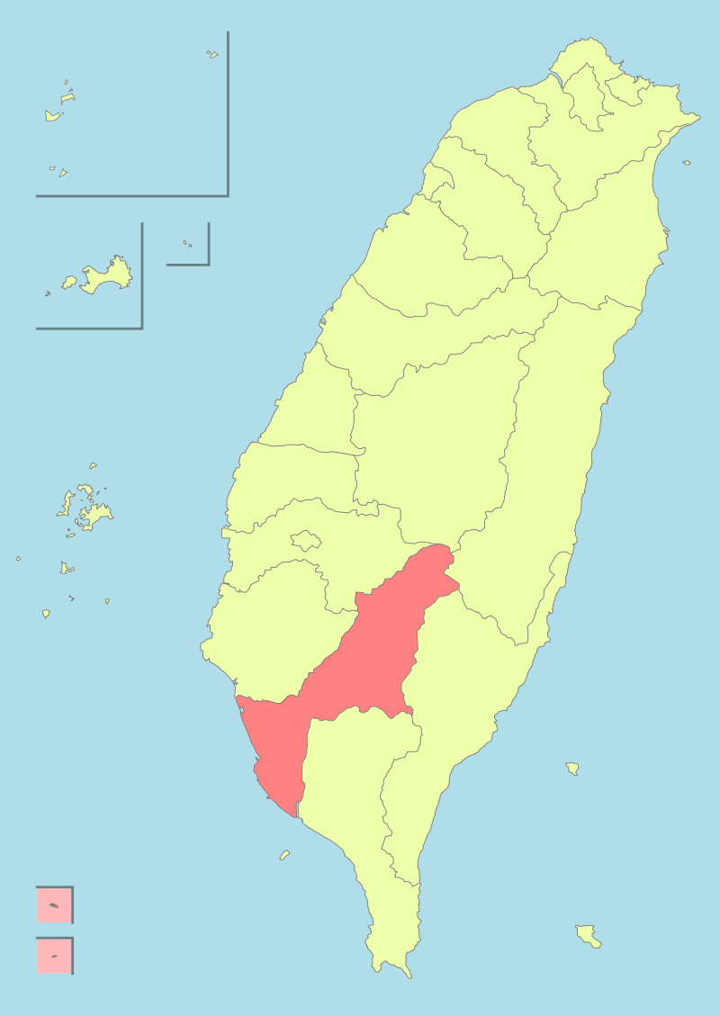
Overview
-Typhoon Morakot in August 2009
-Total of 108 inches of rain, causing dozens of landslides
-Largest landslide at Xiaolin Village near Kaohsiung, Taiwan
-6:16 am : 66 inches of rain accumulated (about 3 days)
-Landslide created a dam at nearby river
-Dam was breached an hour later and wiped out everything
-Killed 400 + people
Notes:
ELISE
Xiaolin village
Shiaolin
Hsiaolin

Slide 3
Before & After

Slide 4
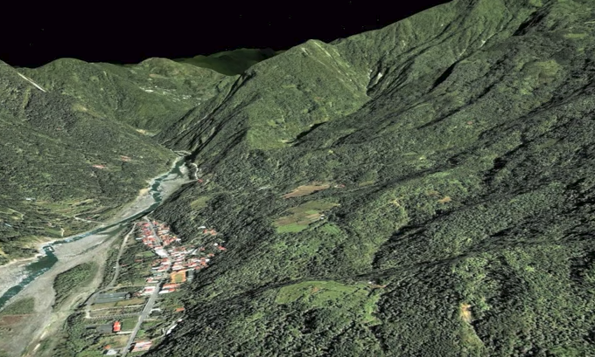
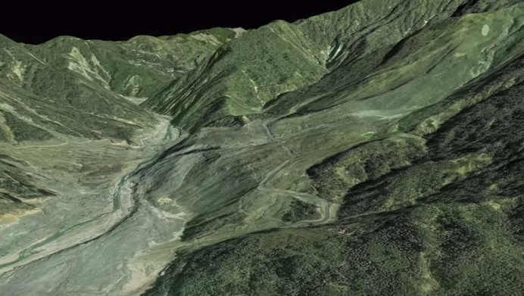

Slide 5
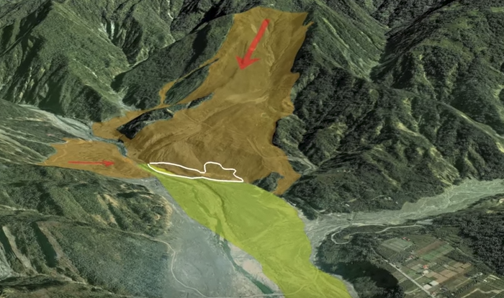

Slide 8
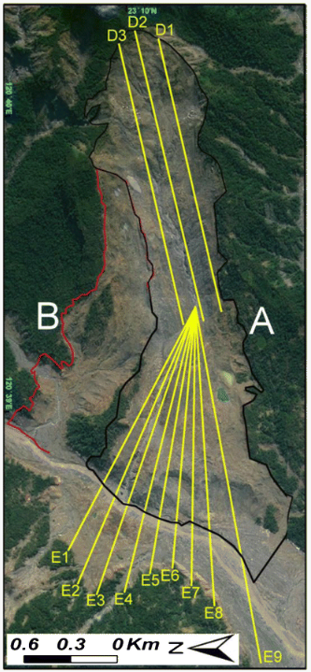
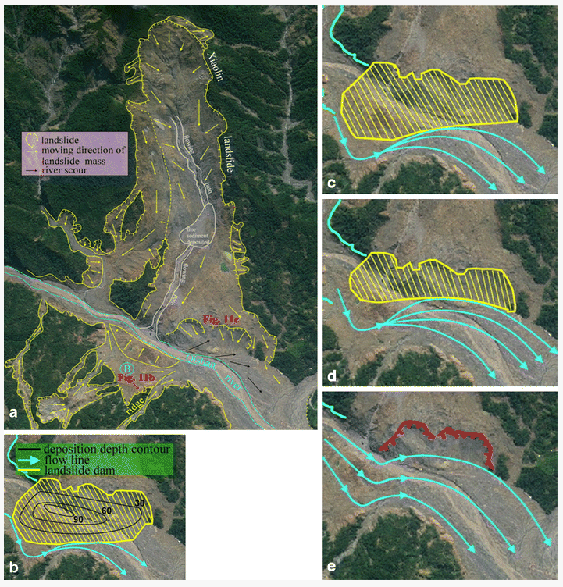
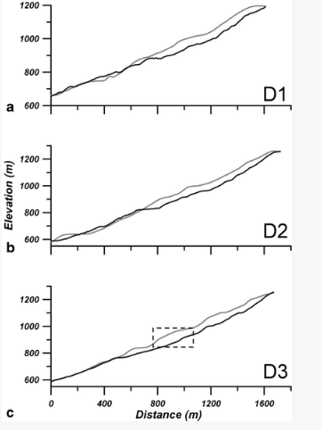
Slope stability analysis done by:
-3D discrete element program
-using DEM’s
-before and after information from Google Earth
-field survey information
-estimated frictional coefficients and strength of the landslide

Slide 9
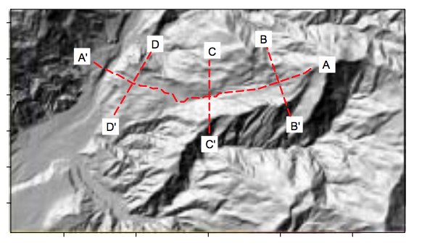
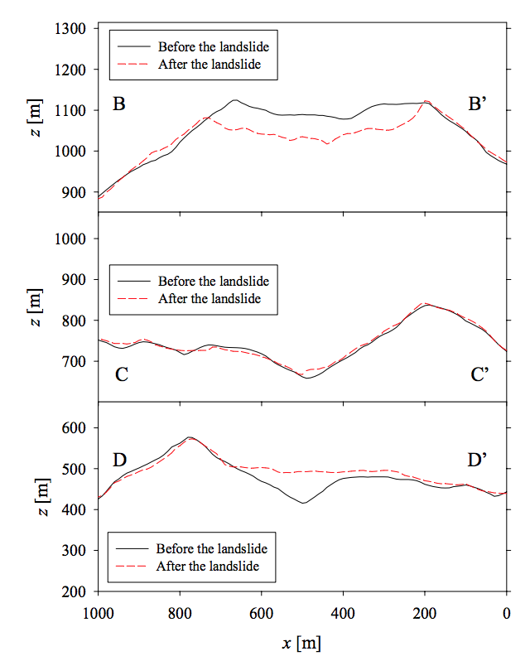
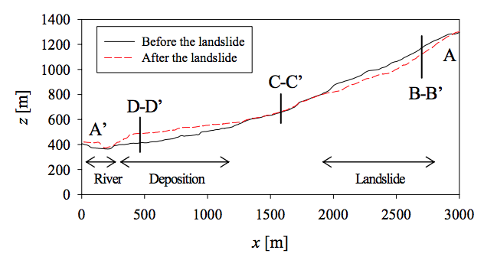

Slide 10
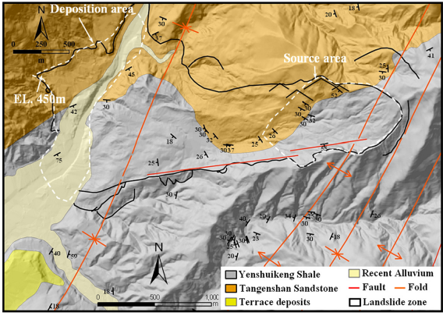
Notes:
Pedro

Slide 11
Causes and Analysis
-Traveled 45-75 mph
-27 million m3 of material (M: 4.6)
-Deep-seated landslide
-2.83 km by 1.63 km (1.8 miles x 1.01 miles)
-465 deaths
-Flexural slip mechanism & dip slope
-Weathering
-Increased pore pressure
Notes:
Jenny
Sliding surface : shale layer

Slide 12
References
Formation, failure, and consequences of the Xiaolin landslide dam, triggered by extreme rainfall from Typhoon Morakot, Taiwan
https://link.springer.com/content/pdf/10.1007%2Fs10346-013-0394-4.pdf
Catastophic landslide induced by Typhoon Morakot, Shiaolin, Taiwan
http://web.nchu.edu.tw/pweb/users/feng/research/9712.pdf
The Landslide Blog
https://blogs.agu.org/landslideblog/2009/09/27/photos-and-text-from-a-visit-to-the-shiaolin-landslide-in-taiwan/
https://www.jstage.jst.go.jp/article/jscejhe/67/4/67_4_I_721/_pdf/-char/en
https://www.youtube.com/watch?v=tWzzntkyIwQ
https://www.youtube.com/watch?v=U-bWMa_QPKQ
https://www.youtube.com/watch?v=jYONmfgGoMI
https://www.youtube.com/watch?v=D59xJBfj1Cc

